Slide 1


Rockbuster Stealth LLC Movie Rental Company Data Analytics Team
January 2023

Slide 2



Project Overview
Rockbuster Stealth LLC is a movie rental company that used to have stores around the world. Currently, it is facing stiff competition from streaming services such as Netflix and Amazon Prime.
Current Understanding
the Rockbuster Stealth management team is planning to use its existing movie licenses to launch an online video rental service in order to stay competitive.
Objective
Which movies contributed the most/least to revenue gain?
What was the average rental duration for all videos?
Which countries are Rockbuster customers based in?
Where are customers with a high lifetime value based?
Do sales figures vary between geographic regions?
Key questions

Slide 3
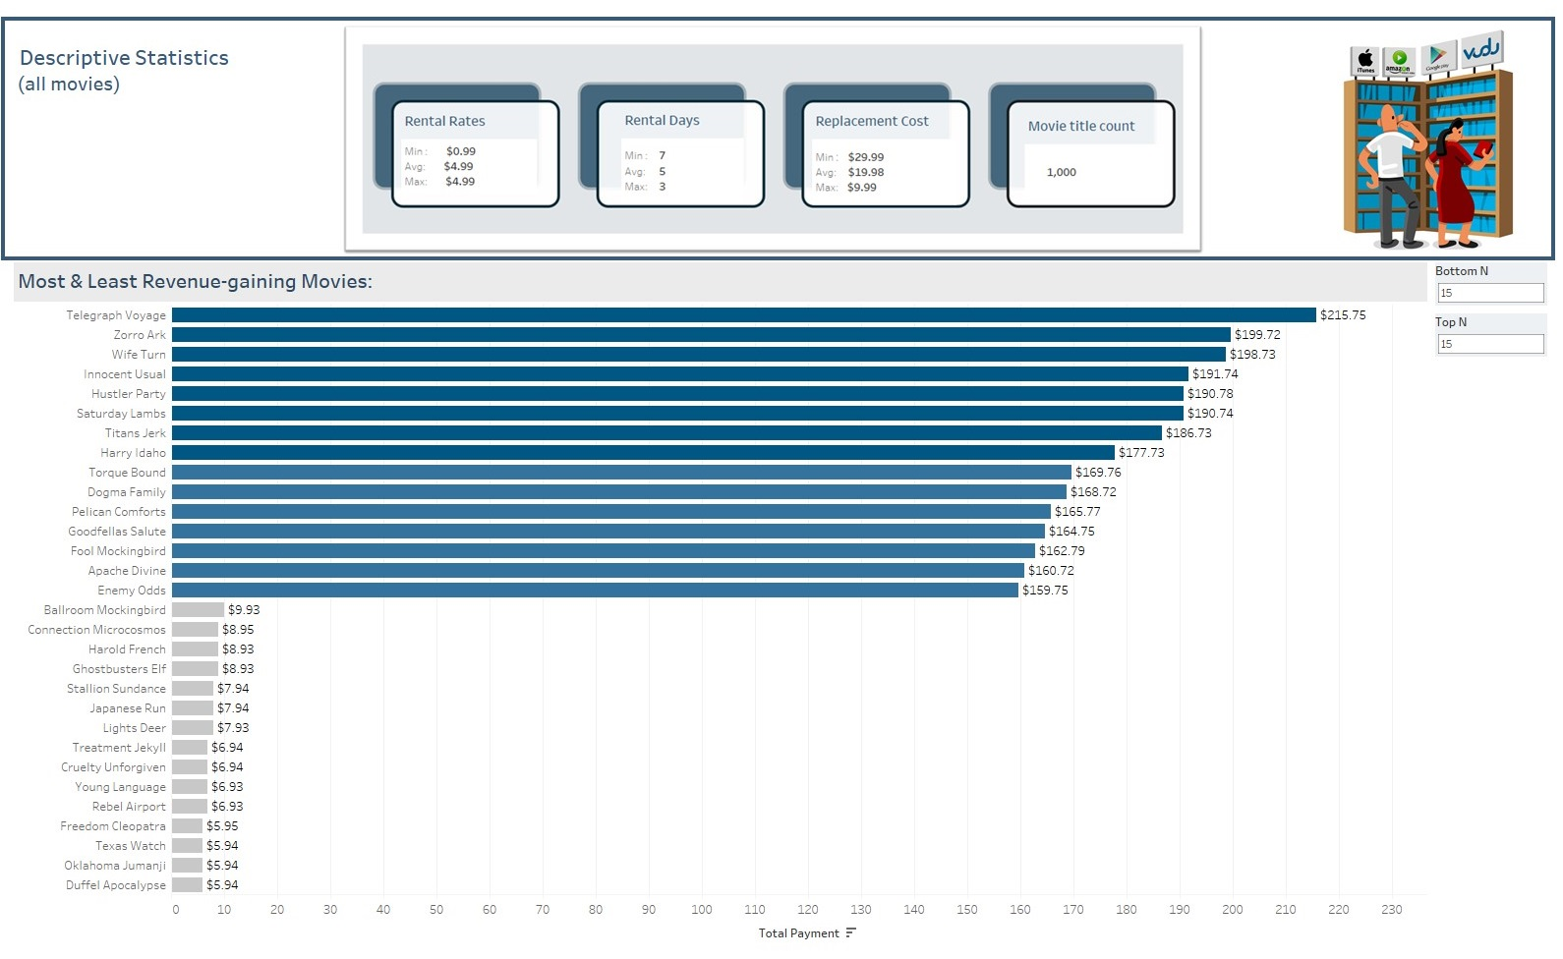


Slide 4
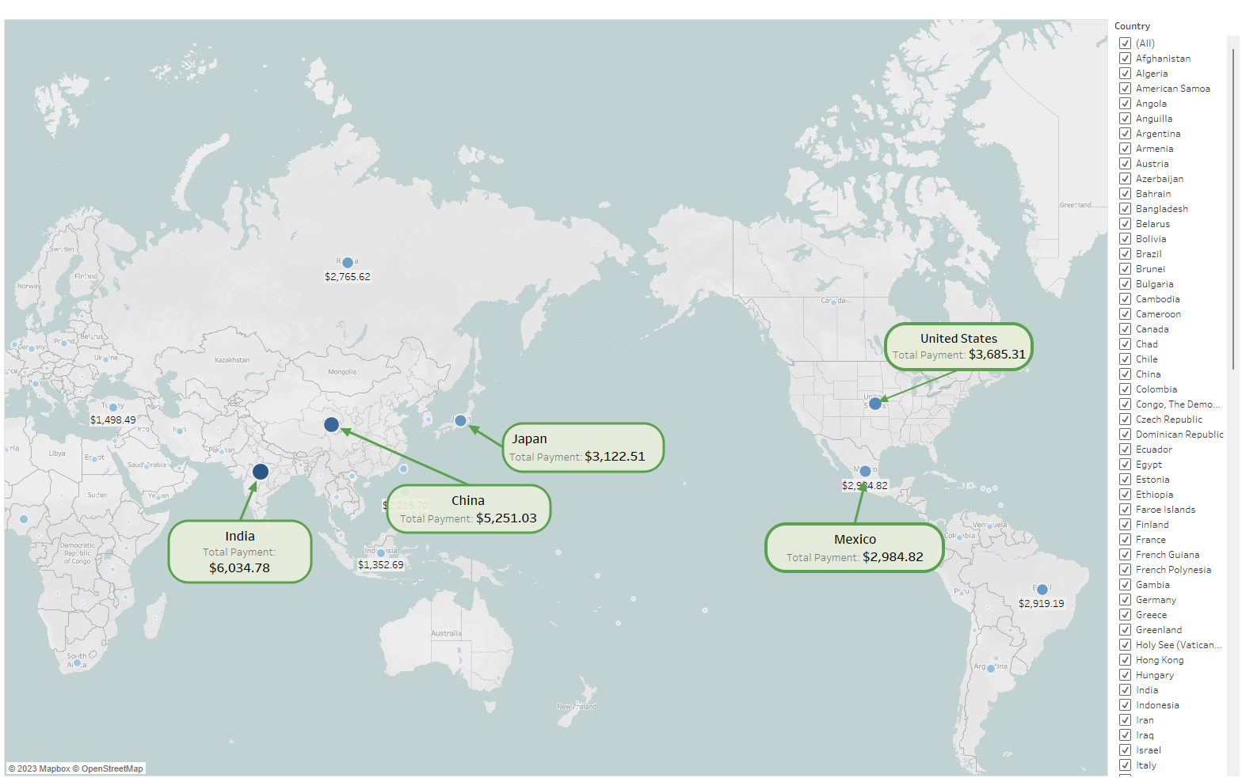
Rockbuster's Top Profitable Countries

Slide 5
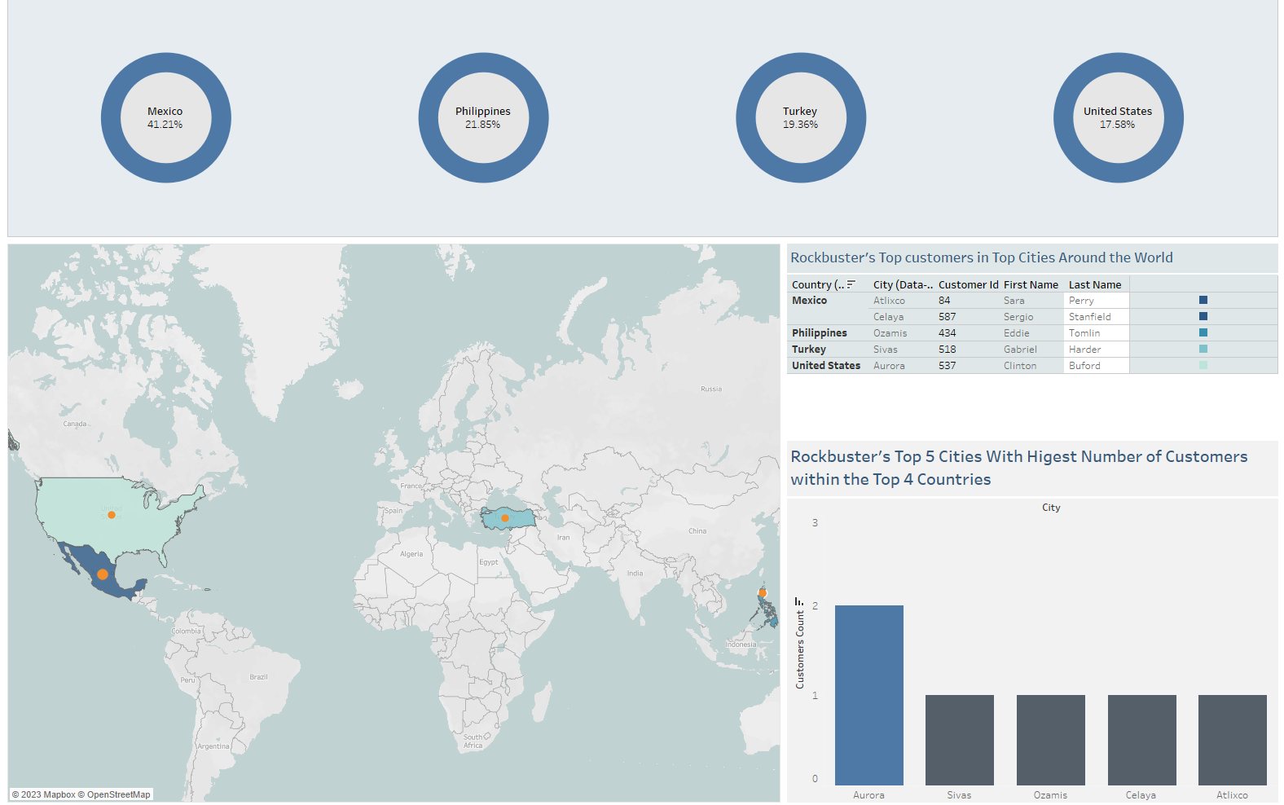
%Top Countries' Revenue Contribution

Slide 6
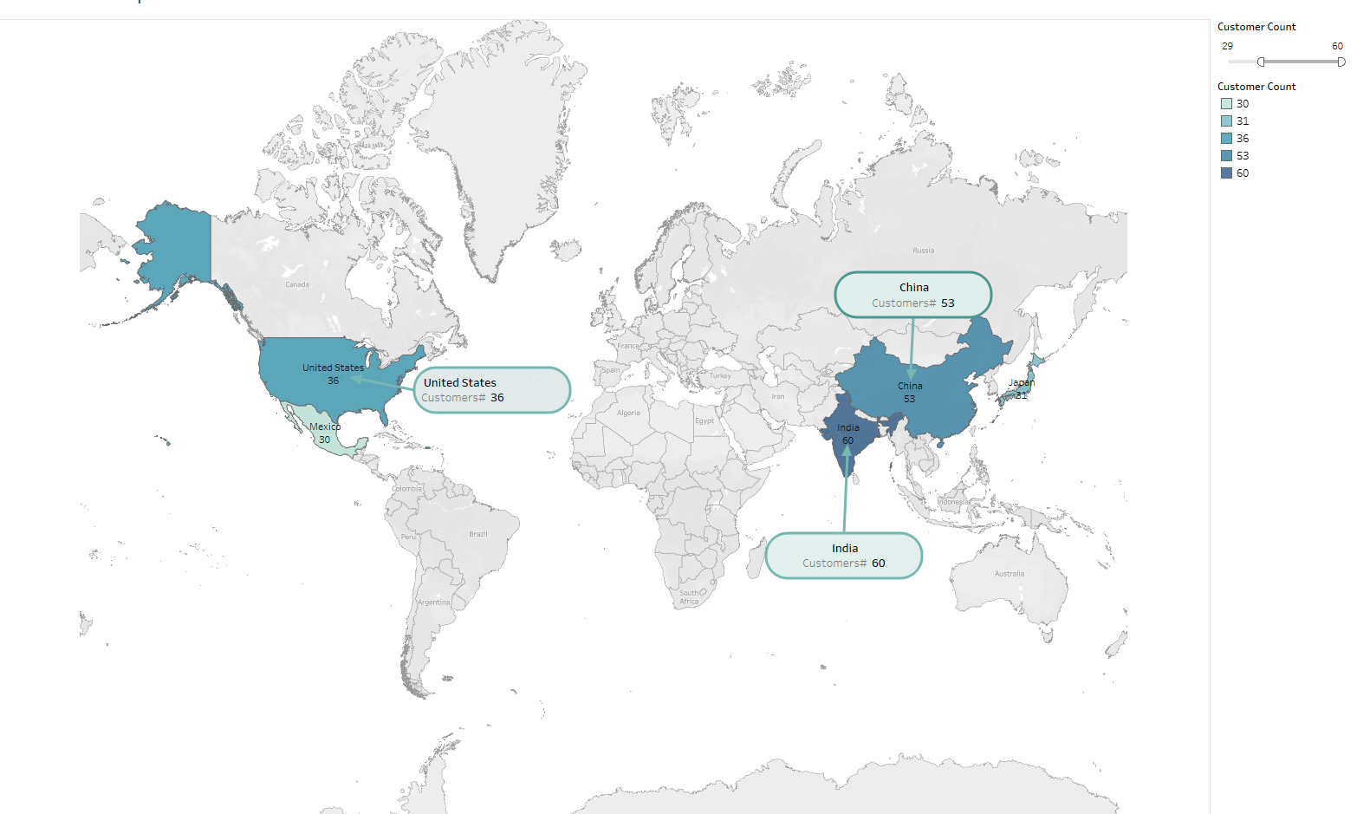
Rockbuster's Top 3 Countries in Number of Customers

Slide 7


Recommendations
Rockbuster has 600 customers in 109 countries all around the world. It is a great opportunity to grow as an online service.
To start the pilot service, we would recommend the top 3 revenue makers: India, China, and the United States.
We suggest the marketing team to provide promotions within popular countries with highest number of customers: India, China, the United States, Japan, and Mexico.
Next step would be to introduce a subscription-based rental program; however, further analysis is required to plan to find the most effective monthly fee to beat the competitors (In physical stores the average rental fee was $2.98 over 5 days. Also, the average of replacement fee was $19.98).
The interactive storyboard is available at: Rockbuster, Movie Rental Company, Storyboard | Tableau Public
For more information or questions please contact us at:
analytics@rockbuster.com

